Slide 1

RISK AND RESILIENCE BOOTCAMP
9

Slide 2


Slide 3
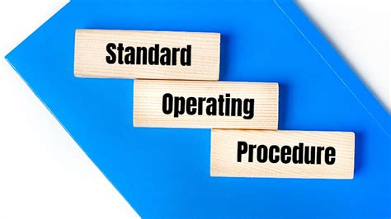
SOPS
This section is an introduction to SOPS
Standard Operating Procedures

Slide 4
SOP
Standard Operating Procedure
Documented, step-by-step set of instructions that describes how to perform specific operational tasks consistently and safely
Translates policy and controls into repeatable actions
In ISACA terms
“A detailed, written instruction to achieve uniformity of the performance of a specific function”
For resilience
“A predefined procedure ensuring continuity of critical operations during normal and abnormal conditions”

Slide 5
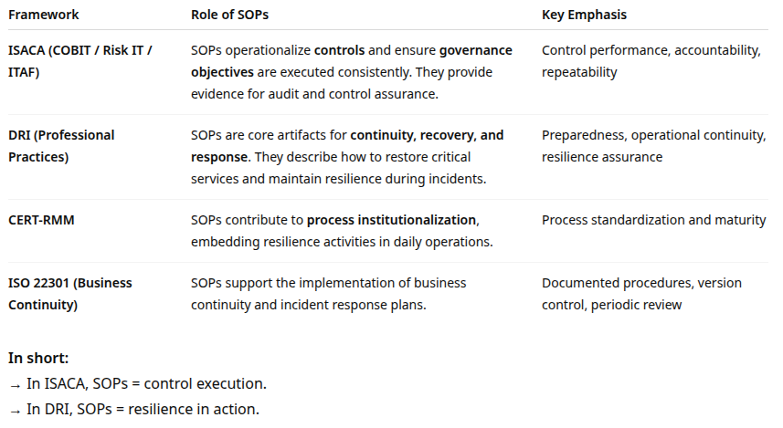
SOP

Slide 6
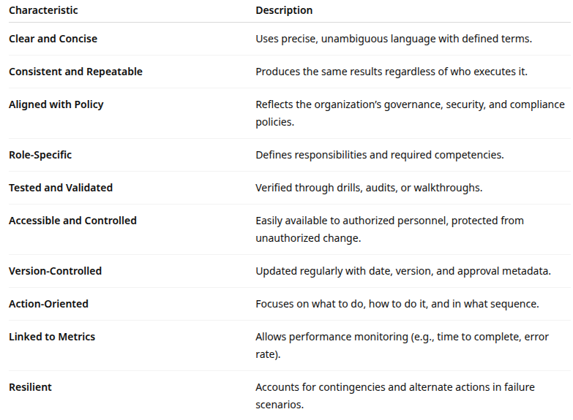
Key characteristics

Slide 7
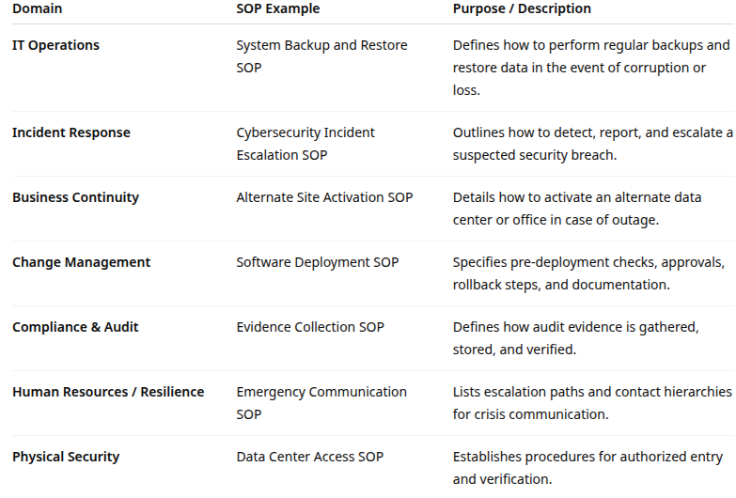
SOP Examples

Slide 8
SOP Development
Development
Identify the need
Triggered by a policy requirement, risk finding, incident, or new control
Define scope and objectives
What task does the SOP cover?
What outcome is expected?
Gather input from SMEs (subject matter experts)
Collaborate with process owners, security, operations, and compliance teams
Draft the SOP
Step-by-step instructions, tools, roles, timing, contingencies

Slide 9
SOP Development
Review and validate
Cross-check accuracy; test through simulations or tabletop exercises
Obtain approval
Formal sign-off from process owner and governance body
Publish and train
Distribute to relevant personnel; ensure accessibility and training

Slide 10
Sop usage
SOPs are used during:
Routine operations (e.g., daily monitoring, backups)
Incident response (reference during a crisis)
Audit or compliance checks (evidence of control performance)
Training (onboarding new staff)
Identify control weaknesses or gaps
Compare current controls to framework expectations or regulatory standards
Determine if gaps arise from low maturity (e.g., no ownership, no automation, poor testing)

Slide 11
Sop maintenance
Periodic review (quarterly/annual):
Ensure procedures remain valid
Change control
Updates must follow formal versioning and approval workflows
Testing
Verify SOP effectiveness through drills or real-world incidents
Archiving
Retain old versions for audit traceability

Slide 12
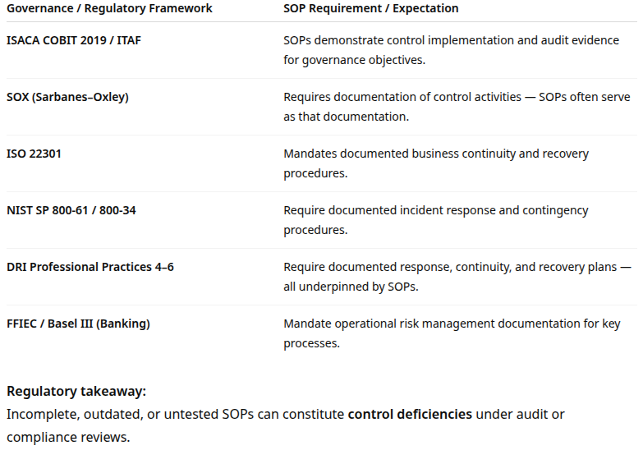
Governance and Regulatory Issues

Slide 13
Best practices
Link SOPs to policies and risks
Every SOP should trace back to a policy statement or control objective
Keep it simple and usable
Avoid dense text
Use checklists, flowcharts, and tables
Use version control and approval logs
Record authors, reviewers, dates, and approvals for audit evidence
Integrate SOPs into training and drills
Test and rehearse them to optimize effectiveness

Slide 14
Best practices
Align SOPs with process maturity
As processes evolve, SOPs must be revised accordingly
Digitize and centralize SOPs
Store in secure document management or GRC systems with access controls
Review after every major incident
Feed lessons learned back into the SOP (continuous improvement)
Ensure cross-functional ownership
SOPs should reflect operations, risk, IT, and compliance collaboration

Slide 15
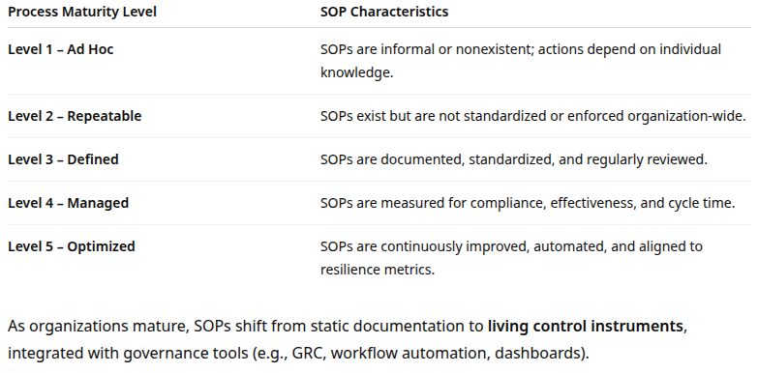
SOPs and Process Maturity

Slide 16
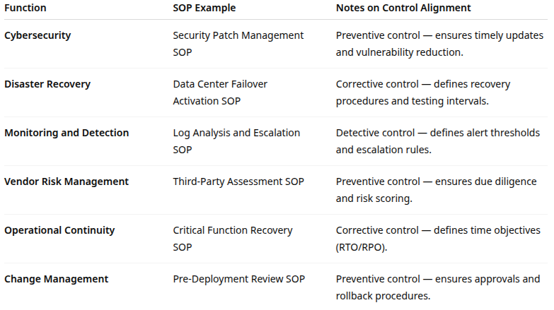
Examples of SOPs by Function

Slide 17

Q&A and open discussion
Notes:
Now is the time to engage in an interactive Q&A session where you can ask questions, share insights, and clarify any doubts about the topics we have covered so far.
This open discussion is designed to ensure that every participant has the opportunity to voice their thoughts and learn from the collective experience of the group.
Your questions and comments are valuable as they help us identify areas that may need further explanation and enable us to tailor future sessions to your needs.
We encourage you to speak up and contribute to the dialogue, as this interaction is one of the key components of our interactive learning approach.
As the session progresses, take note of any questions or ideas that you would like to revisit, and feel free to share your perspectives with the class.

